Slide 1
USDA FSA Prototype Knowledge Elicitation Findings
Version 1
8/22/2018
Includes: Findings and a couple UI changes based upon those findings as evidence of how feedback influenced design

Slide 2
Knowledge Elicitation Findings: General
More use of color/style
Utilize more of the white space to the left and right of pages, but be mindful of responsive design layout
‘I’ icons to for tooltips (what is disabled purposefully, what requires action to make active, and for help)
Ratings descriptives (From responses to a scale of 1-5)
Means: Discuss page (3.25); Analyze page (3)
Frequencies: Discuss page (4); Analyze page (3)

Slide 3
Knowledge Elicitation Findings: Discuss Page
Change top follow button to say “Follow topic”
Change follow buttons within cards to say “Follow post”
Enlarge font size for the graph title (or increase size of the whole graph overall)
Decrease relative font size of poster’s name and timestamp
Add text to timestamps for clarification: ‘Posted on 08/21/2018’
Add posts for topics suggested: Crop Acreage Reporting; Payments; Recently Released Programs

Slide 4
Knowledge Elicitation Findings: Analyze Page
Consider a complete vertical approach where step 3 is underneath step 2; need to reduce the jarring effect of workflow that is top-to-bottom from left-to-right when some step boxes may be longer than the default size of the page
Optional buttons should have a different style than Next buttons, such as like the ‘View’ buttons, confusing what is required and optional
Step 1 box
Move ‘Merge’ button up with ‘Import’ button as they are both optional
Change ‘View’ button to read ‘View source data’ for clarity
Add planned changes (i.e. dataset description, separate datasets into lists/tabs; title case or merge column, import functionality
Step 2 box
Replace analytic text with a phrase or sentence that a novice would understand followed by the analytics name (i.e. Linear Regression) in parentheses
Step 3 box
Provide units of measurement wherever possible for graph axes (where that axis unit of measurement is defined or 100% predictable by the graph type so it can be hard-coded)
Fix bug where the tab in focus reverts back to the first tab
Move the ‘Run Analytic’ button to the left and the Post button to the far right

Slide 5
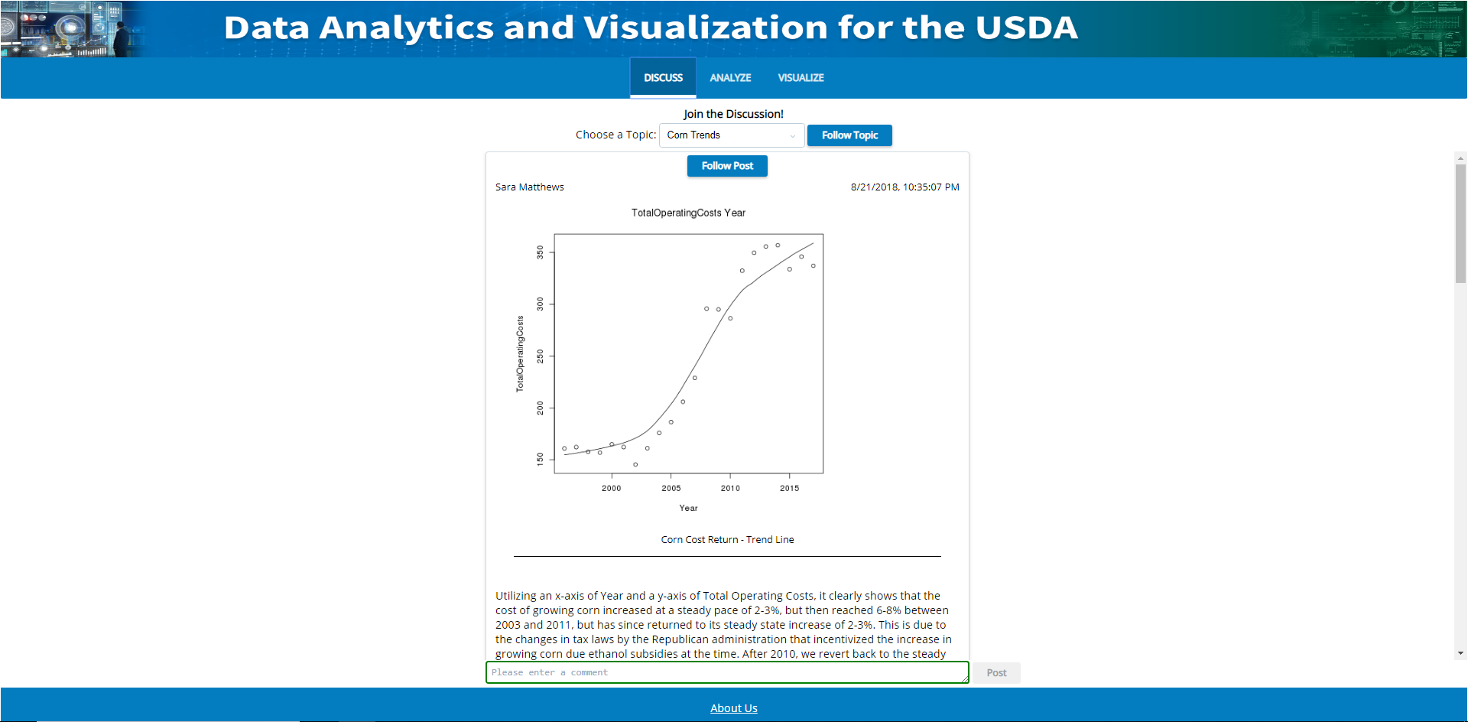

Design Change Based upon Findings: Discuss Page
Analytics and Visualizations for Insights into USDA Data
Join the discussion!
Follow Topic
Corn cost returns tapering off
Insights
Follow Post
Utilizing an x-axis of Year and a y-axis of Total Operating Costs, it clearly shows that the cost of growing corn increased at a steady pace of 2-3%, but then reached 6-8% between 2003 and 2011, but has since returned to its steady state increase of 2-3%. This is due to the changes in tax laws by the Republican administration that incentivized the increase in growing corn due ethanol subsidies at the time. After 2010, we revert back to the steady state growth of 2-3% “the democratic growth rate”
Posted by: Sara Matthews
Posted on: 08/21/2018

Slide 6
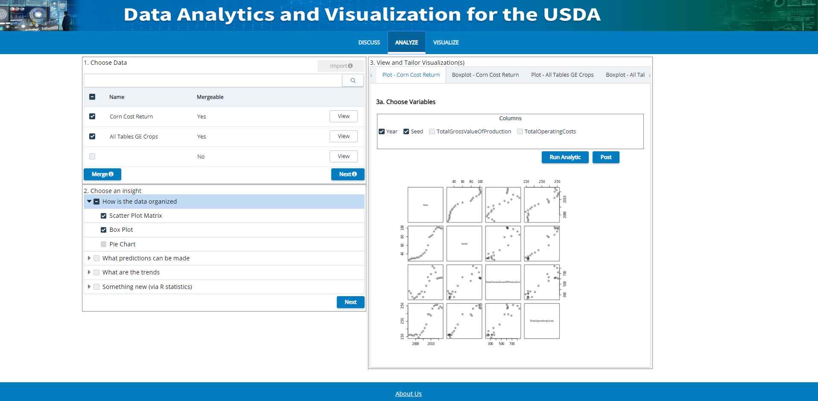
Design Change Based upon Findings: Analyze Page
Analytics and Visualizations for Insights into USDA Data
1. Choose data
2. Choose insight
3. View and tailor visualizations
Merge
Description
3a. Choose variables
Lora imp sum blah...
View File
Lora imp sum blah...
View File
Lora imp sum blah...
View File
Run Analytic
Next
Next
Post

